Slide 1


TIPS AND TRICKS FOR
FABRIC DATA WAREHOUSE
CHRIS HYDE
HYDRATE CONSULTING LLC
Notes:
Presentation Title Slide
Please input your presentation title, your name, title, company name and country.

Slide 2
Notes:
Section Break Slide
Use this slide for starting a new section of the presentation.
Input the name of the section in the text field.

Slide 3
Notes:
Main Content Slide: Title / Copy Text
Use this slide for inserting text-only information into the Main Content of the presentation.
The text is preformatted with font and colour styles.
Font-size can be altered to allow the content to fit the slide correctly.
The Title Text Box can be deleted if not required.

Slide 4

He / him pronouns
Microsoft Data Platform MVP
Independent Analytics and DBA Consultant
Albuquerque data platform group leader
Contact me:
Bluesky: @ChrisHyde325
LinkedIn: /in/chris-hyde-3803706/
Email: chrishyde325@gmail.com
Chris Hyde
Owner and Principal Consultant
Hydrate Consulting, LLC

Slide 5
Agenda
What is Fabric Data Warehouse?
Design for performance
Direct Lake mode in Power BI
Workarounds for T-SQL limitations
My ELT patterns

Slide 6
What is Microsoft Fabric?
Microsoft’s next generation all-in-one data analytics product
Full integration of data warehousing, data engineering, and data science tools into the same portal as Power BI (reporting and data visualization)
Software-as-a-Service (SaaS) rather than Platform-as-a-Service (PaaS)
One copy of data in the integrated OneLake data lake

Slide 7
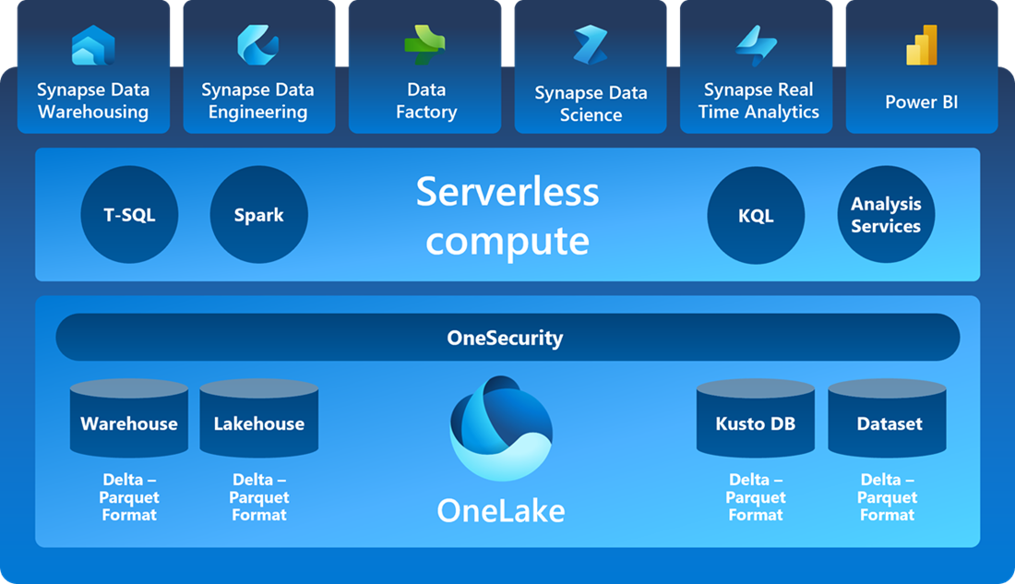
SaaS Foundation

Slide 8
What is Fabric DW?
T-SQL based data warehousing experience
Denormalized tables optimized for reporting
Stored Procedures
Parquet Files
Queryable through query tools, incl. Power BI

Slide 9
1. Consider Latency
Collocate resources where possible
Network latency between client and compute
Network latency between compute and shortcuts
Data latency of large result sets
Notes:
It's easy to forget about the effect of data latency on our Fabric warehouses. After all storage and compute have usually been tightly coupled, as in an on-premises SQL Server data warehouse. However, because Microsoft Fabric is a Software-as-a-Service solution where storage and compute are decoupled, we should stress the co-location, where possible, of both client-to-engine and engine-to-data connections.
When we execute queries, the transfer of the query result sets to the client computer can significantly impact performance, especially with large result sets. If possible, we should ensure that the client computer is in the same region as the Fabric capacity to minimize network latency. If that's not possible, be aware that the number of rows in the result set will impact the query duration. Speaking of the number of rows, we should also keep in mind the that query editor in the Fabric UI returns only the first 10,000 rows of the data set. If we need more, we should connect to the warehouse using SSMS, aka SQL Server Management Studio, or Azure Data Studio. Also, SSMS and Azure Data Studio will give us somewhat better performance anyway compared to the Fabric UI due to their TDS binary format communication with the engine.

Slide 10
2. Table Design – Star Schema
Denormalized data
Fact tables – countable data
Dimension tables – slicing-and-dicing
Also integration tables
Notes:
You'll want to organize the tables in your data warehouse into what is known as a star-schema design. This organizes data into primarily two types of tables, fact and dimension tables. Fact tables contain quantitative, or countable, data that are commonly generated in your transactional systems. For example, sales transaction details, or patient appointments, or as in the image shown on the next slide, NY taxi cab trips.
Dimension tables contain descriptive data about different attributes of your data. For example, the name and address of the customer placing a sales order, the demographics of a particular patient, or dates and location of taxi trips. These are the attributes that are commonly used to "slice-and-dice" or group your data on.
This design facilitates analytical processing by de-normalizing the data from your highly normalized OLTP systems, ingesting transactional data and enterprise master data into a common, cleansed, and verified data structure that minimizes JOINS at query time, reduces the number of rows read and facilitates aggregations and grouping processing.
You will also find that you have a third category of table called an integration table. These might be staging tables used to store the raw data that has been ingested via a pipeline from your OLTP systems, or perhaps temporary integration tables used to store the results of intermediate steps and calculations as you are transforming your data.
You have a number of different ways to organize your data using different schema names, table prefixes, and multiple warehouses. I prefer to avoid table prefixes and instead use different schemas to separate my fact and dimension tables, although I will often call these schemas data and lookup rather than fact and dim to be more easily understood by my analysts. And because Fabric fully supports cross-warehouse querying using a three-part naming convention, I will usually separate out my integration tables into different staging warehouses to keep them separate from the conformed and verified data.

Slide 11
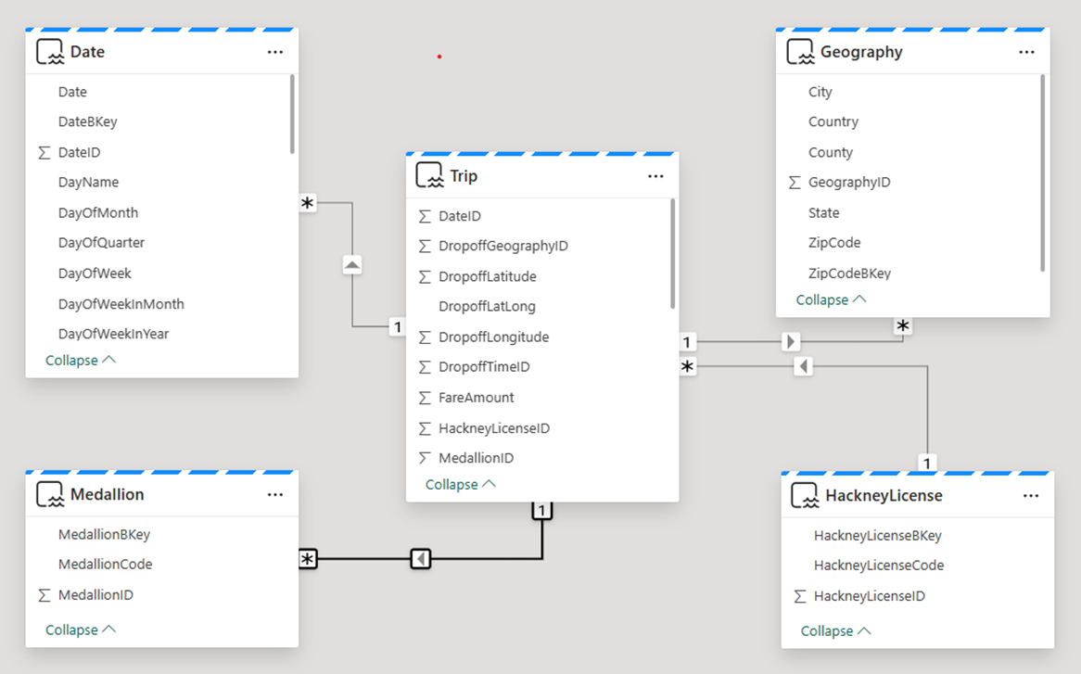
2. Table Design – Star Schema
Notes:
Dimension tables contain descriptive data about different attributes of your data. For example, the name and address of the customer placing a sales order, the demographics of a particular patient, or dates and location of taxi trips. These are the attributes that are commonly used to "slice-and-dice" or group your data on.
This design facilitates analytical processing by de-normalizing the data from your highly normalized OLTP systems, ingesting transactional data and enterprise master data into a common, cleansed, and verified data structure that minimizes JOINS at query time, reduces the number of rows read and facilitates aggregations and grouping processing.
You will also find that you have a third category of table called an integration table. These might be staging tables used to store the raw data that has been ingested via a pipeline from your OLTP systems, or perhaps temporary integration tables used to store the results of intermediate steps and calculations as you are transforming your data.
You have a number of different ways to organize your data using different schema names, table prefixes, and multiple warehouses. I prefer to avoid table prefixes and instead use different schemas to separate my fact and dimension tables, although I will often call these schemas data and lookup rather than fact and dim to be more easily understood by my analysts. And because Fabric fully supports cross-warehouse querying using a three-part naming convention, I will usually separate out my integration tables into different staging warehouses to keep them separate from the conformed and verified data.

Slide 12
3. Table Design – Data Types
Use the smallest data type possible
Use data types supported by parquet
Use varchar instead of char; NOT NULL instead of NULL in key fields
Validate table schemas created by tools (e.g. Pipelines)
https://learn.microsoft.com/en-us/fabric/data-warehouse/data-types
Notes:
Analyzing your data to find what data types and ranges can be expected will pay off with performance benefits as well. Try to use the smallest data type that accommodates your values, such as a SMALLINT instead of a BIGINT for a year number column. But keep in mind that not all data types you may be used to from SQL Server are available in Fabric, as they do not have matching data types in Delta Parquet.
You should specify the precision and scale of all decimals, use varchar instead of char for strings, and declare columns as NOT NULL wherever possible, especially in key fields. Also, if your table has been created by a tool rather than a CREATE TABLE script, for example using Pipelines, you'll want to double-check that appropriate data types were created. Let’s see some examples of these guidelines on the next slide, and then we’ll see a quick demo of the potential problems created by pipelines.

Slide 13
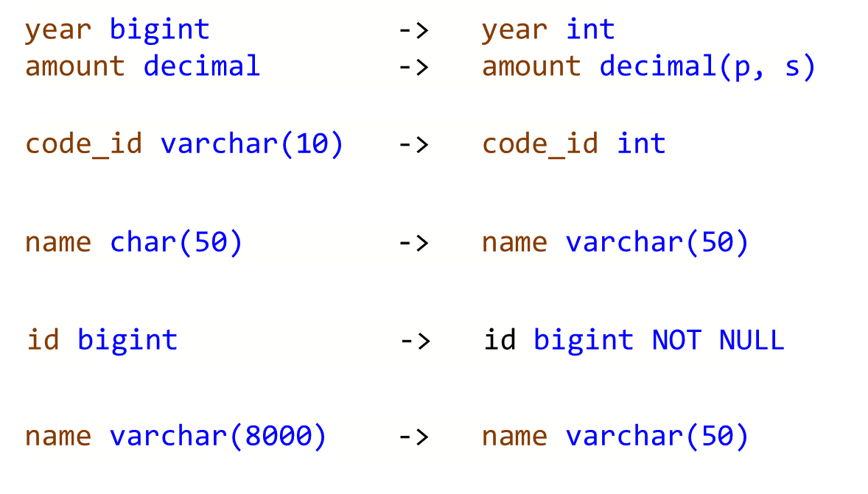
3. Table Design – Data Types

Slide 14
Data Pipeline Demo

Slide 15
4. Consider Direct Lake Limitations
Power BI Direct Lake mode (diagram next slide)
Several current limitations
Limitations detailed at: https://learn.microsoft.com/en-us/power-bi/enterprise/directlake-overview#known-issues-and-limitations

Slide 16
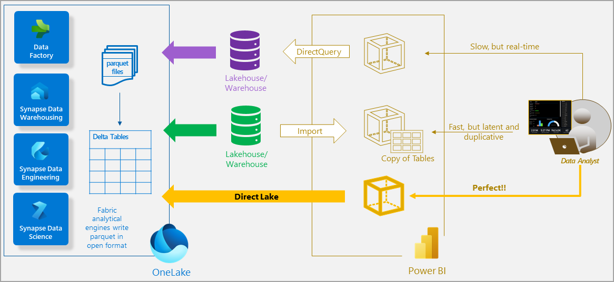

Slide 17
Unsupported in Direct Lake
Model contains tables from more than one warehouse
Model contains calculated columns and tables
Model contains relationships based on datetime columns
Key column data types do not coincide or are not unique

Slide 18
Fallback to DirectQuery
A query reads data from a view contained in the model
SSO authentication is used when SQL endpoint security has been defined

Slide 19
Schema Patterns
On premises:
fact and dim contain tables
data and lookup contain views
etl contains orchestration items
In Fabric Data Warehouse:
data and lookup contain tables
etl contains orchestration items

Slide 20
Slowly-Changing Dimensions
Type 0 – no updates
calendar / date tables
Type 1 – update in place; no historical record reqd.
college example – student name
Type 2 – data versioning
college example – gender and ethnicity
Can mix within same dimension table

Slide 21
Dimension Metadata Fields
Source System Name
Source System Key
SCD Type 1 Hash Value
SCD Type 2 Hash Value
Active Record Flag
Start Effective Date (in warehouse)
End Effective Date (in warehouse)
Record Last Updated Date/Time

Slide 22
Sentinel Values
Default dimension members
Unknown
e.g. Student record mismatch
Missing
e.g. Student grades for in-process classes

Slide 23
T-SQL Limitation #1
No temp tables
Making complex business logic simpler
Separating complex business logic from “plumbing”
Workaround - Physically materialize a table in temp schema
But watch out for – Concurrent updates
Notes:
Dim_Term_GetData

Slide 24
T-SQL Limitation #2
No INSERT INTO… EXEC from a stored procedure
Re-locate transformation logic
Separating complex business logic from “plumbing”
Workaround – Use physical “temp” tables
But watch out for – Concurrent updates
Notes:
Dim_Term_InsertUpdate

Slide 25
T-SQL Limitation #3
No MERGE statement
Is this really a limitation? ☺
Workaround - Separate INSERT and UPDATE statements
But watch out for – Handling transactions
Notes:
EDW.etl.Lookup_Term_InsertUpdate

Slide 26
T-SQL Limitation #4
No IDENTITY() columns
Workaround - Use ROW_NUMBER() function plus a seed
But watch out for – No real issues here
Notes:
EDW.etl.Lookup_Term_InsertUpdate

Slide 27
6. Leverage the Lakehouse
File Storage
Medallion Architecture options
Bronze and Silver layers in the Lakehouse
Gold layer in the Warehouse
Lakehouse shortcuts to Data Warehouses in different workspaces

Slide 28
Resources
https://github.com/DrJekyll325/Presentations
aka.ms/fabric-learn
aka.ms/FabricRoadmap

Slide 29
Notes:
Main Content Slide – Dark Background: Title / Copy Text
Use this slide for inserting text-only information into the Main Content of the presentation.
The text is preformatted with font and colour styles.
Font-size can be altered to allow the content to fit the slide correctly.
The Title Text Box can be deleted if not required.

Slide 30
Notes:
Main Content Slide : Title + Dual Copy Text
Use this slide for inserting two columns of text-only information into the Main Content of the presentation.
The text is preformatted with font and colour styles.
Font-size can be altered to allow the content to fit the slide correctly.
The Title Text Box can be deleted if not required.

Slide 31
Notes:
Main Content Slide – Dark Background : Title + Dual Copy Text
Use this slide for inserting two columns of text-only information into the Main Content of the presentation.
The text is preformatted with font and colour styles.
Font-size can be altered to allow the content to fit the slide correctly.
The Title Text Box can be deleted if not required.

Slide 32
Notes:
Main Content Slide: Visual-Data Only
Use this slide for inserting visual-data only (table, graph, image, video etc.) into the Main Content of the presentation.

Slide 33
Notes:
Main Content Slide : Title / Copy Text + Visual-Data
Use this slide for inserting text and visual-data into the Main Content of the presentation.
Font-size can be altered to allow the content to fit the slide correctly.
The Title Text Box can be deleted if not required.

Slide 34
Notes:
Main Content Slide – Dark Background : Title / Copy Text + Visual-Data
Use this slide for inserting text and visual-data into the Main Content of the presentation.
Font-size can be altered to allow the content to fit the slide correctly.
The Title Text Box can be deleted if not required.

Slide 35
Notes:
Main Content Slide: Visual-Data + Title / Copy Text
Use this slide for inserting visual-data and text information into the Main Content of the presentation.
Font-size can be altered to allow the content to fit the slide correctly.
The Title Text Box can be deleted if not required.

Slide 36
Notes:
Main Content Slide: Title + Dual Visual-Data
Use this slide for inserting two types of visual-data into the Main Content of the presentation.
Font-size can be altered to allow the content to fit the slide correctly.
The Title Text Box can be deleted if not required.

Slide 37





aka.ms/FabricCommunity Connect with community members, ask questions, and learn more about Fabric
Get Involved
in the Fabric
Community
aka.ms/FabricUserGroups
Find a user group that matches your interests in your area or online
aka.ms/SuperUsers
Spread your Fabric knowledge, insights, and best practices with others
aka.ms/MVP Technology experts that share their knowledge and passion with the community
Notes:
Main Content Slide: Title + Dual Visual-Data
Use this slide for inserting two types of visual-data into the Main Content of the presentation.
Font-size can be altered to allow the content to fit the slide correctly.
The Title Text Box can be deleted if not required.

Slide 38

FREE Microsoft Fabric
Certification Exam
Are you ready to get Fabric certified by the end of October?
Claim your 100% discount voucher for Exam DP-600: Fabric Analytics Engineer.
Come find us in the Community Lounge under the Get Certified banner to learn more!
aka.ms/FabCon24/IAmReady
Notes:
Main Content Slide: Title + Dual Visual-Data
Use this slide for inserting two types of visual-data into the Main Content of the presentation.
Font-size can be altered to allow the content to fit the slide correctly.
The Title Text Box can be deleted if not required.

Slide 39
Notes:
End Slide: Rate This Session
Final Slide on all presentations.
The speaker should not edit, move or delete this slide.

